Slide 1
Cyclistic bike share
recommendations for converting casual riders to annual members

Slide 2
Contents
Introduction
Background
Question: How to convert casual riders to annual members
Source Data
Analysis Slides
Key Findings
Recommendations
Data Analysis Process

Slide 3
introduction
Brian Hafner
Details of analysis: Cyclist Capstone – Brian Hafner Tech Blog
LinkedIn: Brian Hafner | LinkedIn
Email: bh@brianhafner.com

Slide 4
background
Founded in 2016, Cyclistic is a successful bike-share program in Chicago with a fleet of 5,824 geotracked bicycles across 692 stations.
Cyclistic offers flexible pricing plans: single-ride passes, full-day passes, and annual memberships. Customers are categorized as casual riders (single-ride or full-day passes) and members (annual memberships).
Cyclistic’s finance analysts found that annual members are more profitable than casual riders.
The company’s goal is to convert casual riders into annual members by understanding their needs and preferences through the analysis of historical bike trip data.

Slide 5
Question: How to convert casual riders to annual members
Lily Moreno, the director of marketing has determined the best path for the company is to convert casual riders to annual members.
We have been tasked with determining how casual riders use Cyclistic bikes differently from annual members to help determine how to convert those casual riders into annual members.

Slide 6
data source
I use the January thru December 2023 data files located here.
https://divvy-tripdata.s3.amazonaws.com/index.html

Slide 7
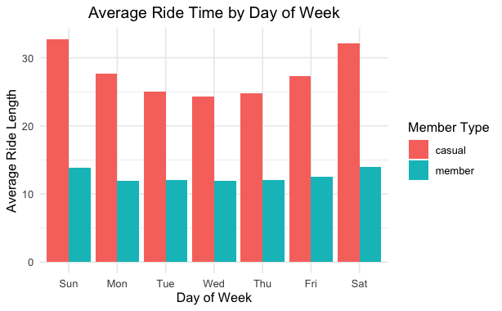
average ride time by day of week in 2023
As can be expected, ridership peaks for casual riders on Saturday Sunday.
Ridership for members is
Notes:
Consider talking about:
Data requirements
Data collection
Data processing
Data cleaning
Exploratory data analysis
Modeling and algorithms
Data product
Communication

Slide 8
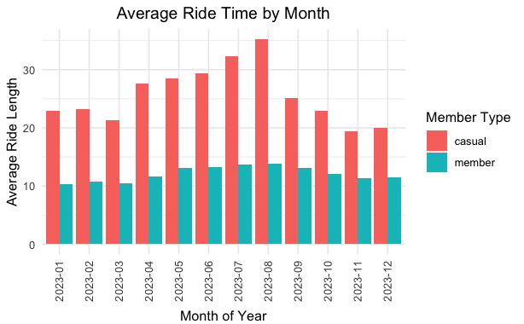
average ride time by month in 2023
Ridership time for casual riders starts increasing from April and peaks in August, before dropping back down from Sept. to Dec.
Ridership for members is relatively steady across all months.
Notes:
Consider talking about:
Data requirements
Data collection
Data processing
Data cleaning
Exploratory data analysis
Modeling and algorithms
Data product
Communication

Slide 9
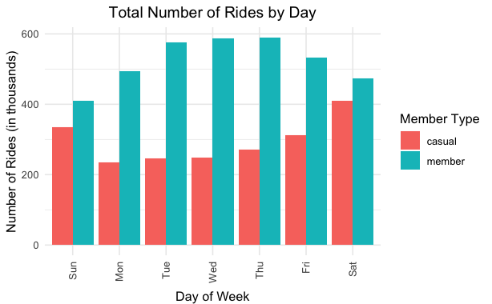
total rides by month in 2023
When we look at total rides per day, there seems to be an inverse relationship between casual riders and annual members, with annual member taking more trips mid-week.
Notes:
Consider talking about:
Data requirements
Data collection
Data processing
Data cleaning
Exploratory data analysis
Modeling and algorithms
Data product
Communication

Slide 10
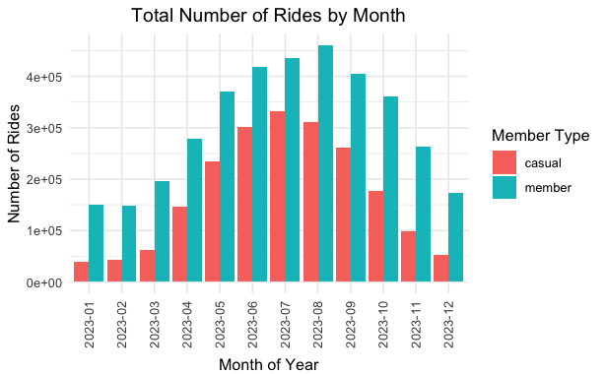
total rides by month in 2023
When we look at total rides per month, the total number is higher in the warmer months and lower in the winter.
Both casual riders and annual members follow a similar pattern.
Notes:
Consider talking about:
Data requirements
Data collection
Data processing
Data cleaning
Exploratory data analysis
Modeling and algorithms
Data product
Communication

Slide 11
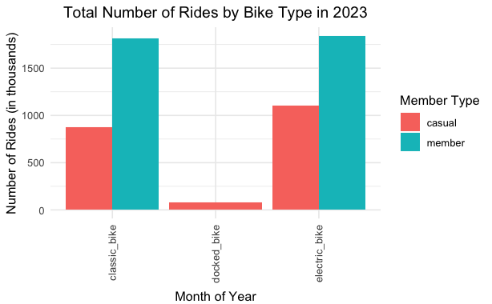
total rides by bike type in 2023
The classic bikes and electric bikes were very popular, but there is very little demand for the docked bikes. We might want to look at phasing that out.
Notes:
Consider talking about:
Data requirements
Data collection
Data processing
Data cleaning
Exploratory data analysis
Modeling and algorithms
Data product
Communication

Slide 12
key findings
Average ride time for annual members is pretty steady throughout the year. While casual riders use the service much more in the warm months.
Ridership time for casual riders starts increasing from April and peaks in August, before dropping back down from Sept. to Dec. Ridership for members is relatively steady across all months.
When we look at total rides per day, there seems to be an inverse relationship between casual riders and annual members, with annual member taking more trips mid-week.
When we look at total rides per month, the total number is higher in the warmer months and lower in the winter. Both casual riders and annual members follow a similar pattern.
The classic bikes and electric bikes were very popular, but there is very little demand for the docked bikes. We might want to look at phasing that out.

Slide 13
recommendations
Offer incentives to casual riders in the colder month to persuade them to use the bikes more in the colder months, when the total time they spend on the bike is less.
Offer incentives mid-week to encourage casual riders to use the bikes, when they are normally less active.
Target marketing for both casual riders and members for the colder months when they use the service less. Although members to to have the same length of trips, regarless of when they use the bike, they make fewer trips in the colder months.
The classic bikes and electric bikes were very popular, but there is very little demand for the docked bikes. We might want to look at phasing out the docked bikes.

Slide 14
further analysis
If we could get more data such as address or zip code, we could analyze use patterns at a neighborhood level, and they may allow us to fine time marketing and incentives by neighborhood, allowing for a more effective campaign.
Other demographic data like income levels, age and gender would allow us to do a more detailed analysis with better recommendations. If that data becomes available, we should factor it into the analysis.
Current pricing of fees paid by the casual riders and annual members would also help find ways to convert those casual riders into annual members.

Slide 15
The process of data analysis
I did all my analysis and reporting in R.
You can see the details of my analysis on this R Markdown page: https://brianhafner.info/cyclist-capstone/
Notes:
Consider talking about:
Data requirements
Data collection
Data processing
Data cleaning
Exploratory data analysis
Modeling and algorithms
Data product
Communication

Slide 16
references
R Best Practices - Krista L. DeStasio, M.S (https://kdestasio.github.io/post/r_best_practices/)

